Slide 1

Impacts on Closing Costs and Interest Rates
April 22, 2014
Winter/Spring 2019

Slide 2
Introduction
During this seminar we will discuss:
What are closing costs and why do I have to pay them?
Overview of standard closing costs
What impacts my interest rate?
Loan Estimate review
Questions & Answers

Slide 3
Closing Costs
In a real estate transaction there is an exchange of funds. Closing costs are fees and expenses over and above the price of the property, incurred by the buyer and the seller during the transfer of property.
Closing costs can be fixed charges or can be based on the loan amount or purchase price.
It is important to get an estimate of closing costs from your lender prior to application.

Slide 4
Closing Costs
Application Fee:
Money charged to the borrower at the time of application. This is generally a flat fee, which is meant to cover the lender’s costs associated with the review of the mortgage application.
Origination Fee:
A fee charged by the lender for processing a loan application, expressed as a flat fee or a percentage of the mortgage amount.
Underwriting Fee:
A fee charged by a lender to review and render a decision on a loan application.
Appraisal Fee:
An appraisal fee is charged by a licensed appraiser to determine property value. It is a comparative analysis of properties that have sold within the last six months.

Slide 5
Closing Costs
Credit Report Fee:
A fee charged by the lender to access the borrower’s credit profile in order to determine credit qualification. The fee is paid to the credit bureaus - TransUnion, Equifax and Experian.
Tax Service Fee:
A fee that is charged for the purpose of setting up and monitoring the borrower’s property tax payment by a third party.
Flood Certification Fee:
A fee charged by the lender to determine whether the subject property is in a flood zone (if so, flood insurance is required).
Messenger Fee:
A fee charged by the lender to cover any costs related to the delivery of documents to other parties and/or vendors.

Slide 6
Closing Costs
Settlement Agent/Bank Attorney Fee:
Fee charged for the attorney representing the lender at closing.
Title Search:
In purchase transactions involving ‘real property’, the buyer needs to be certain that the seller owns the property and has the legal right to transfer ownership. A title search is used to research the ownership history of the property.
Lien Search:
Similar to title search, but required for a co-op (not real property) transaction. Only a search of any outstanding liens is required. Inexpensive compared to title search and insurance.

Slide 7
Closing Costs
Title Insurance (Required for ‘Real Property’):
Insurance to protect all parties against loss in the event of a property dispute.
Owners Coverage – Optional but necessary. An insurance policy for the buyer that insures the property’s full purchase price. The insurance premium is paid at settlement and coverage is in effect for the life of the property ownership. The cost is based on the purchase price of the home.
Lenders Coverage – Required. A title insurance policy for the lender that insures the amount of the loan. The insurance premium is paid at settlement and coverage is in effect for the life of the property ownership. The cost is based on the loan amount.

Slide 8
Closing Costs
Government Recording Fees:
Fees paid to a municipality to cover the costs of recording legal documents.
Mortgage Tax:
A fee that is charged by a state or local municipality based on the principal amount of the loan.
New York mortgage tax varies on a county basis and ranges between 1 – 2% of the loan amount.
There is no mortgage tax in New Jersey.
There is no mortgage tax on a co-op apartment.
Escrows:
The lender establishes an escrow account to pay yearly property taxes and insurance. The amount set aside at closing is determined by when and how often the payment(s) is due.

Slide 9
Closing Costs
Daily Interest/Per Diem Interest:
A daily interest charge paid at closing based on the day of the month closing occurs.
The following costs are not bank related charges but are costs ‘outside’ the closing:
Attorney Fee:
Fee paid to your attorney to represent you at the closing.
Transfer Taxes:
Fee paid to the state/local government to cover the cost of transferring ownership. Typically paid by the seller unless new construction (read your contract!).
Home Inspection:
Typically done by an engineer to inspect structural and systems-related items.

Slide 10
What Affects Interest Rates?
Beware….All interest rates are not equal. Lenders ALWAYS advertise their very best rates. What can affect interest rates?
Down Payment – the more you put down, the lower the interest rate
Credit Scores – the higher your credit score, the lower the interest rate
Loan Amount – is your loan > $453,100? If so, your rate may be higher
Discount Points – optional, added fees you may pay to reduce your interest rate
Type/Term of Loan – ARMs typically lower; the shorter the term, the lower the interest rate

Slide 11
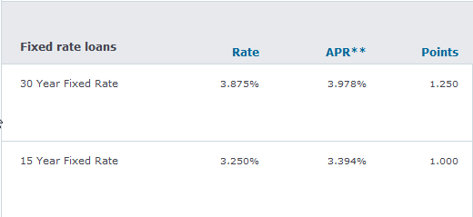
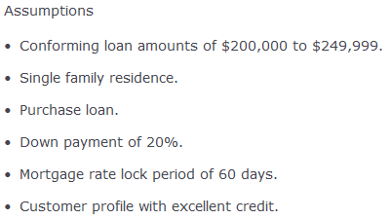
Read the Fine Print
The below rates are advertised on a very large bank’s website:
The fine print indicates the following:

Slide 12
Compare Apples to Apples
Just because one lender has lower closing costs does not mean it is the best deal. You have to look at your mortgage as a complete package – including closing costs, interest rates, restrictions and other features.
Do not always go for the lowest closing costs or the lowest interest rate.
If you pay nothing upfront, your "costs" may be included in your loan in the form of a higher interest rate or stiffer prepayment penalties.
Request a Loan Estimate. It’s the only way to compare apples to apples. See attached sample.

Slide 13
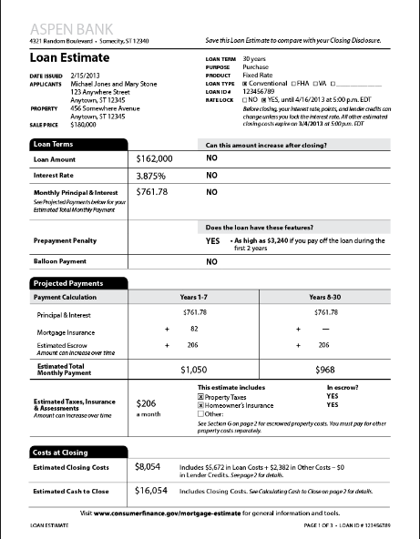
Compare Apples to Apples
A Loan Estimate (LE) is provided only after a loan application has been submitted
Page 1 – Summarizes the transaction and includes:
loan amount
loan term
interest rate
monthly principal and interest payment
Cash needed at closing

Slide 14
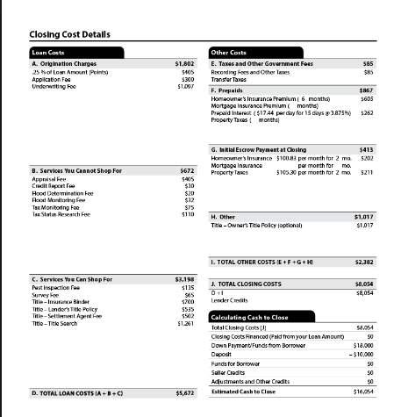
Compare Apples to Apples
Page 2 – Itemizes the closing cost details:
breaks out into sections
multiple closing costs can be combined
All lenders MUST use the same document

Slide 15
Next Steps
Establish a realistic home-buying budget
Down payment, closing costs, interest rates, insurance & taxes, etc.
Determine what type of home you are interested in.
Assemble your team:
Lender – NYUFCU
Realtor - Sign up with the Welcome Home Program - a FREE partner of NYUFCU
Attorney – Don’t wait too long
Get Pre-Qualified and later Pre-Approved with NYUFCU

Slide 16

Summary
Now is a great time to buy a home:
Mortgage rates are still near all time lows.
Property values have begun to stabilize.
Inventory is relatively low – be prepared to move quickly!

Slide 17

Consult With An Expert
Meeting and speaking with a mortgage expert is the best way to navigate the mortgage and home buying process.

Slide 18

Questions?

Slide 19


Please contact us
Visit us online at www.nyufcu.com to download a Mortgage Loan Application Checklist or the interactive Mortgage Loan Application.
Follow us for promotions and new services:
Main Office
NYU Federal Credit Union 726 Broadway, Suite 110 New York, NY 10003-6696 Phone: 212-995-3166
@NYUBanking
NYU Federal Credit Union

Slide 20

Make an Appointment
Make an appointment with NYU FCU for a free Pre-Approval. Call 212-995-3166.
An NYUFCU Representative can assist you: -Calculate the estimated total monthly payment. -Find the right product for your needs.
NYUFCU team at 726 Broadway

